Slide 1
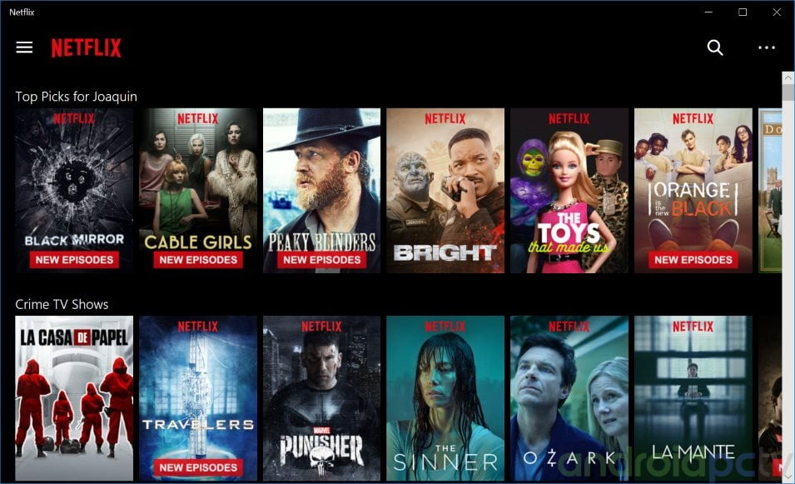

Movie Recommendation
Tejashri Bhilare
DSC 680 – Applied Data Science
Bellevue University

Slide 2

Introduction
Recommendation systems are advanced filtering tools designed to deliver personalized content to users.
By analyzing user preferences and behaviors, these systems predict how likely a user is to enjoy specific content.
Platforms such as Netflix, Amazon, and YouTube utilize these technologies to enhance user experience and retention. This project outlines key approaches to building a movie recommendation engine.

Slide 3

Types of Recommendation Systems
Demographic Filtering- offers users with similar demographic background with the movies that are popular and well-rated regardless of the genre or any other factors. The System recommends the same movies to users with similar demographic features.
Content Based Filtering- consider the object’s contents, this system uses item metadata, such as genre, director, description, actors, etc. for movies, to make these recommendations, it provides movie recommendation more closely to the individual’s preference.
Collaborative Filtering- focuses on user’s preference data and recommensd movies based on it through matching with other users’ historical movies that have a similar preference as well and does not require movies’ metadata. This system matches persons with similar interests and provides recommendations based on this matching.

Slide 4
Why Recommendation Systems Matter
Personalizes content delivery
Enhances user satisfaction
Widely used in entertainment and e-commerce

Slide 5
Dataset Overview
Dataset: MovieLens Latest
100,000+ ratings
9,000+ movies
600+ users
Includes metadata such as genres, tags, and titles
Source: https://grouplens.org/datasets/movielens/latest/

Slide 6
Movie
Dataset
Fields
budget - The budget in which the movie was made.
genre - The genre of the movie, Action, Comedy ,Thriller etc.
keywords - The keywords or tags related to the movie.
original_language - The language in which the movie was made.
original_title - The title of the movie before translation or adaptation.
overview - A brief description of the movie.
popularity - A numeric quantity specifying the movie popularity.
release_date - The date on which it was released.
runtime - The running time of the movie in minutes.
tagline - Movie's tagline.
title - Title of the movie.
Credits
Dataset
Fields
movie_id - A unique identifier for each movie
cast - The name of lead and supporting actors
crew - The name of Director, Editor, Composer, Writer etc.

Slide 7
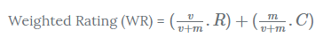
Demographic Filtering
This technique recommends movies that are popular among users with similar demographic characteristics. To ensure fairness, we use IMDB's weighted rating formula:
Where:
v = number of votes
m = minimum votes required
R = average rating
C = mean rating across the dataset

Slide 8
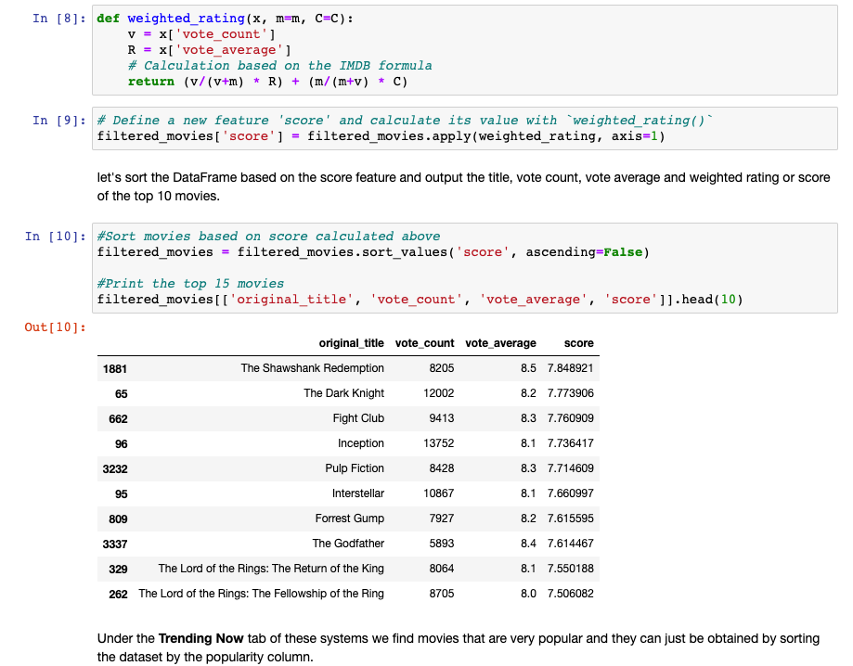
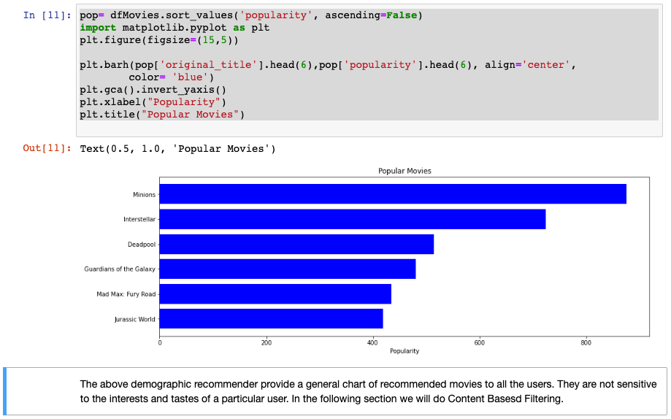
Demographic Filtering – Code Snippet

Slide 9
Content Based Filtering
This approach analyzes metadata such as plot descriptions. Steps:
01
Compute TF-IDF vectors from plot overviews
02
Use cosine similarity to identify similar movies
03
Sort and recommend the top similar titles Example: A user who likes “Inception” may also like other Christopher Nolan films, not just other sci-fi titles.
04

Slide 10
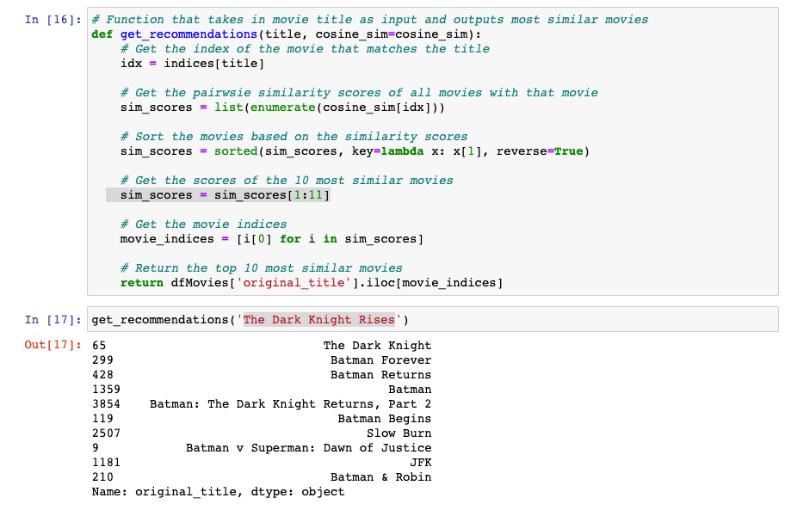
Content Based Filtering – Code Snippet
As we see, the quality of recommendations is not that great. "The Dark Knight Rises" returns all Batman movies while it is more likely that the people who liked that movie are more inclined to enjoy other Christopher Nolan movies. This is something that cannot be captured by the present system.

Slide 11
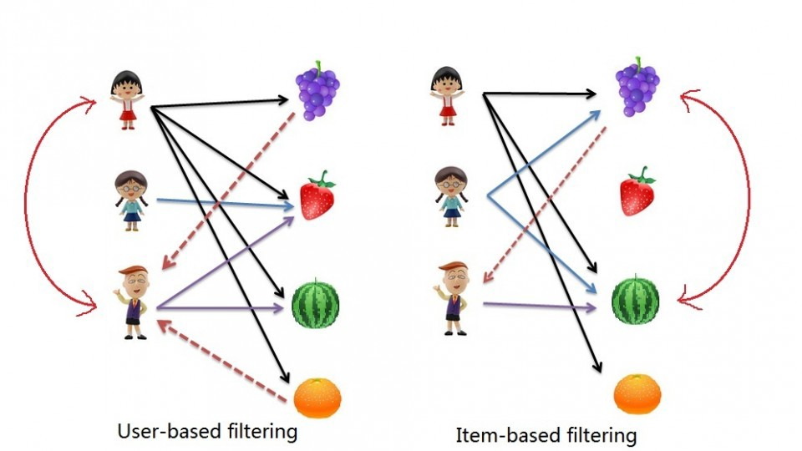
Collaborative Filtering
Uses user behavior to make predictions. Two approaches:
User-Based: Finds users with similar tastes
Item-Based: Recommends items similar to what the user liked Uses algorithms like k-nearest neighbors, cosine similarity, or Pearson correlation.

Slide 12
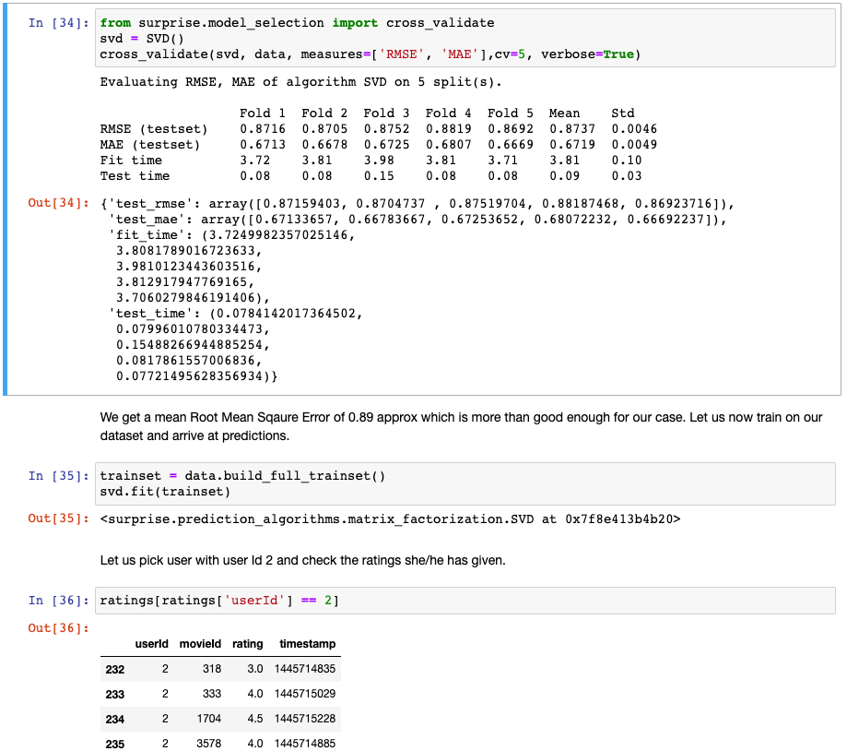
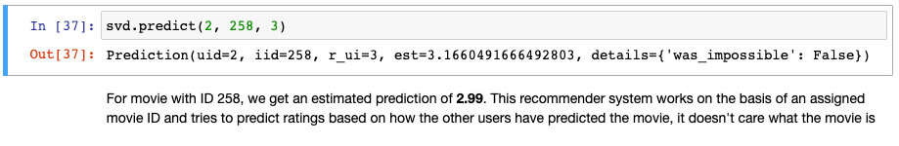
Collaborative Filtering – Code Snippet

Slide 13


Hybrid Model & Improvements
Combines content-based and collaborative filtering
Balances strengths of both approaches
Addresses cold-start and data sparsity issues Future Improvements:
Enhance model accuracy
Improve user interface
Scale to real-time data streams

Slide 14
Conclusion
Recommendation systems significantly enhance user experience by providing relevant content. A hybrid approach using both collaborative and content-based techniques delivers better performance and personalization. Future development will focus on system optimization and user engagement..

Slide 15

Thank You

